Slide 1
Date Picker & Apachi POI
2025
Poornima

Slide 2
Date Picker
Handling a Date Picker in Selenium depends on whether it's a custom UI-based calendar widget or an HTML5 input type="date". Below is a full guide for both scenarios.
Always use explicit waits for dynamic calendars.
Don't rely on sendKeys() if the input is read-only or JS-driven.
Consider edge cases: current vs. future months, leap years, etc.
Use JavaScriptExecutor if the date field is not interactable via Selenium.
📅 1. Handling HTML5 <input type="date">
These date pickers allow direct value entry using sendKeys():
// For example, <input type="date" id="dob">
WebElement dateInput = driver.findElement(By.id("dob"));
dateInput.sendKeys("2025-06-12"); // Format: yyyy-MM-dd
📆 2. Handling Custom Calendar Widgets
Custom date pickers render a calendar UI where you need to:
Click to open the calendar
Navigate to the correct month/year
Click on the desired date

Slide 3
Date Picker
✅ Example Scenario:
Let's say you have a custom calendar like this:
<input id="calendarInput">
<div class="datepicker">
<span class="month">June</span>
<span class="year">2025</span>
<button class="next">Next</button>
<table>
<td class="day">12</td>
</table>
</div>
✅ Selenium Code to Handle It:
// 1. Click to open the calendar
driver.findElement(By.id("calendarInput")).click();
// 2. Wait for calendar to be visible
WebDriverWait wait = new WebDriverWait(driver, Duration.ofSeconds(10));
wait.until(ExpectedConditions.visibilityOfElementLocated(By.className("datepicker")));
// 3. Navigate to correct month & year
while (true) {
String month = driver.findElement(By.className("month")).getText();
String year = driver.findElement(By.className("year")).getText();
if (month.equals(“January") && year.equals(“2026")) {
break;
} else {
driver.findElement(By.className("next")).click();
}
}
// 4. Select the day
driver.findElement(By.xpath("//td[text()=‘05']")).click();

Slide 4
Date Picker
Example: Using Actions for a Date Picker
Suppose you have a calendar icon that appears only on hover, or a date cell that needs a special click:
// 1. Hover over calendar icon
WebElement calendarIcon = driver.findElement(By.id("calendarIcon"));
Actions actions = new Actions(driver);
actions.moveToElement(calendarIcon).click().perform();
// 2. Wait for calendar to appear
WebDriverWait wait = new WebDriverWait(driver, Duration.ofSeconds(10));
wait.until(ExpectedConditions.visibilityOfElementLocated(By.className("calendar-popup")));
// 3. Click on a date using Actions
WebElement dateToSelect = driver.findElement(By.xpath("//td[text()=‘05']"));
actions.moveToElement(dateToSelect).click().perform();
🛠 When to Use Actions with Date Pickers
The calendar appears only on mouse hover.
Clicking using element.click() doesn't work reliably.
You need to hover over month/year dropdown before selection.
If the Actions class also fails due to JavaScript-heavy behavior, try using JavaScriptExecutor as a fallback:
JavascriptExecutor js = (JavascriptExecutor) driver;
js.executeScript("arguments[0].click();", element);

Slide 5
How to handle Dynamic elements
A dynamic element is a web element whose properties (like ID, class, XPath, etc.) change every time the page is loaded or during interaction. For example:
<input id="username_123" type="text">
Here, 123 might change on each load.
🔧 Strategies to Handle Dynamic Elements
1. Use XPath with contains() or starts-with()
If the element ID or other attributes are partially static, use functions like contains() or starts-with():
// Using contains
driver.findElement(By.xpath("//input[contains(@id,'username_')]")).sendKeys("admin");
// Using starts-with
driver.findElement(By.xpath("//input[starts-with(@id,'username_')]")).sendKeys("admin");

Slide 6
How to handle Dynamic elements
2. Use normalize-space() for text-based elements
To ignore extra spaces in visible text:
driver.findElement(By.xpath("//button[normalize-space()='Submit']")).click();
3. Use following-sibling, preceding-sibling, or other XPath axes
If an element has a relative position to a stable element:
// Clicking a button next to a label
driver.findElement(By.xpath("//label[text()='Email']/following-sibling::input")).sendKeys("test@example.com");
4. Use CSS Selectors
CSS selectors are often shorter and more readable:
// Match class that starts with
driver.findElement(By.cssSelector("input[id^='username_']")).sendKeys("admin");
// Match class that ends with
driver.findElement(By.cssSelector("input[id$='_name']")).sendKeys("admin");

Slide 7
How to handle Dynamic elements
5. Explicit Waits with Expected Conditions
Dynamic elements may take time to load. Always use WebDriverWait:
WebDriverWait wait = new WebDriverWait(driver, Duration.ofSeconds(10));
WebElement dynamicElement = wait.until(ExpectedConditions.visibilityOfElementLocated(By.id("dynamicElementId")));
dynamicElement.click();
6. JavaScriptExecutor as a last option
When Selenium fails to click or interact:
JavascriptExecutor js = (JavascriptExecutor) driver;
js.executeScript("arguments[0].click();", dynamicElement);
7. Use dynamic XPath with multiple conditions
If a single attribute isn’t reliable, combine multiple:
driver.findElement(By.xpath("//input[@type='text' and contains(@class,'input-lg')]")).sendKeys("value");

Slide 8
How to handle Dynamic elements
Best Practices for Handling Dynamic Elements in Selenium
Use Relative XPath
CSS Selectors for Dynamic Elements
Use Explicit Waits
Handle Dynamic IDs with Patterns
Leverage JavaScript Executor
Use Unique Attributes Wherever Possible

Slide 9
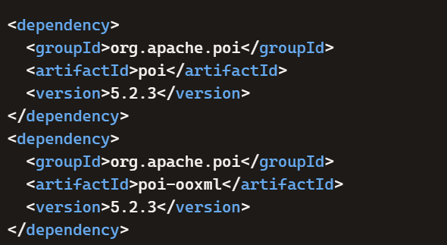

Apachi POI
You can use Apache POI with Selenium to perform data-driven testing by reading and writing Excel files. Apache POI is a Java library that lets you interact with Microsoft Office documents, especially Excel, so you can store test data in spreadsheets and feed it into Selenium script
Add Apache POI Dependency
If using Maven, include in pom.xml:
2. Prepare Excel File
Create an Excel sheet with test data (e.g., usernames, passwords, URLs).

Slide 10
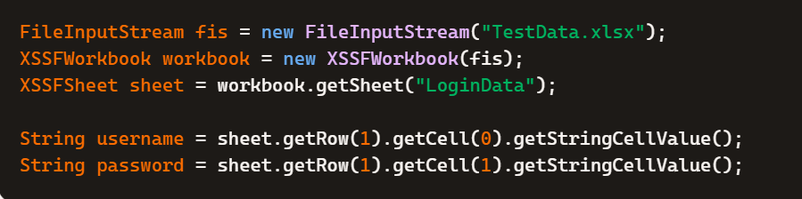
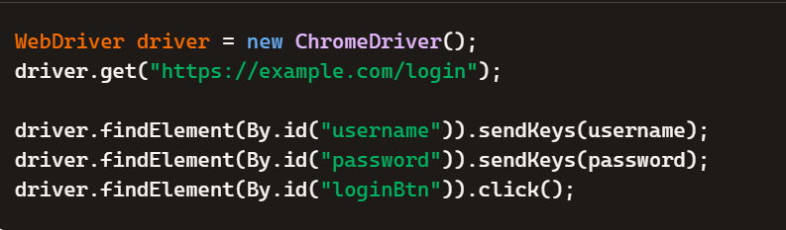
Apachi POI
3. Read Data from Excel
Use Apache POI classes:
FileInputStream → open file
XSSFWorkbook → workbook
XSSFSheet → sheet
XSSFRow & XSSFCell → rows and cells
4. Use Data in Selenium

Slide 11
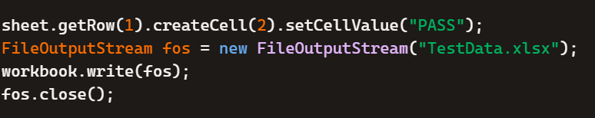
Apachi POI
5. Write Back Results to Excel
You can also log test results:
Why Use Apache POI with Selenium?
Feature | Benefit
Data-driven testing | Run tests with multiple datasets easily
Reusable test cases | Avoid hardcoding values in scripts
Collaboration | Non-technical team members can edit Excel files
Result logging | Store test outcomes back into Excel

